Slide 1
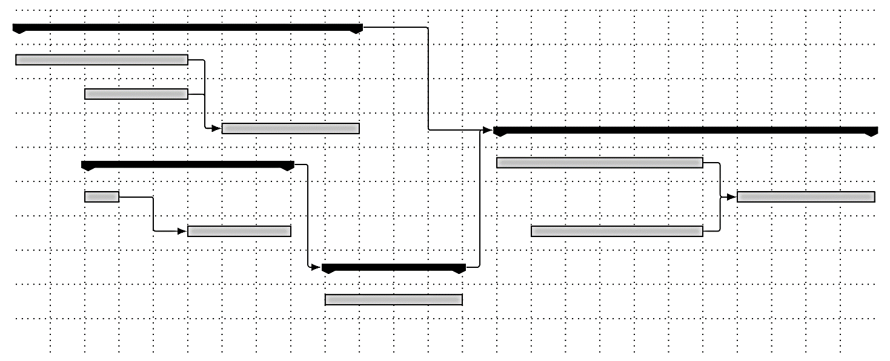
SWOP – TaskMan iteratie 2
Door Tim Van Den Broecke,
Joran Van de Woestijne,
Vincent Van Gestel en
Eli Vangrieken

Slide 2
Inleiding
Refactoring iteratie 1
Design overzicht
Domain strength
Testing

Slide 3
Refactoring iteratie 1- Views

Slide 4
Refactoring iteratie 1- State

Slide 5
Refactoring iteratie 1- Observer

Slide 6
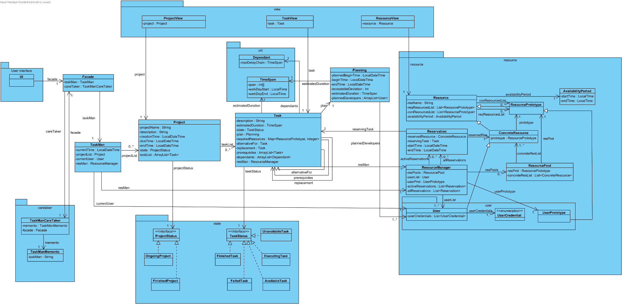
Het Design – overzicht

Slide 7
Het Domein

Slide 8
Use Cases

Slide 9
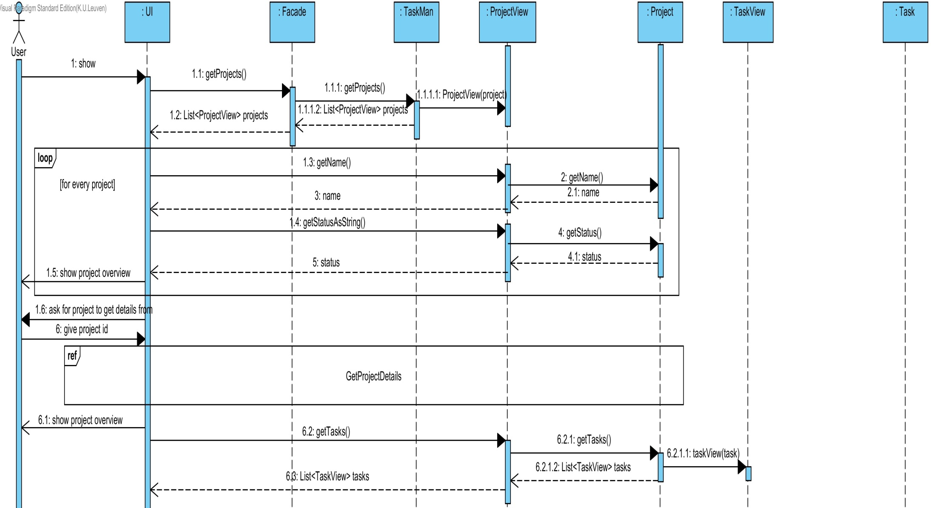
UC1: Show Projects

Slide 10
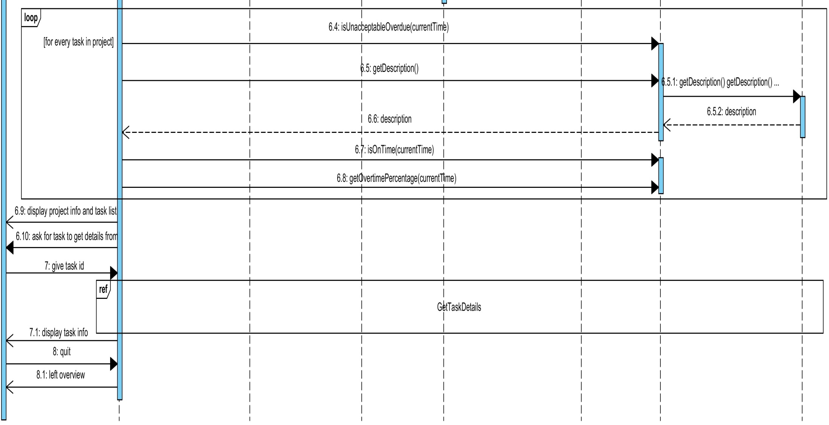
UC1: Show Projects part 2

Slide 11
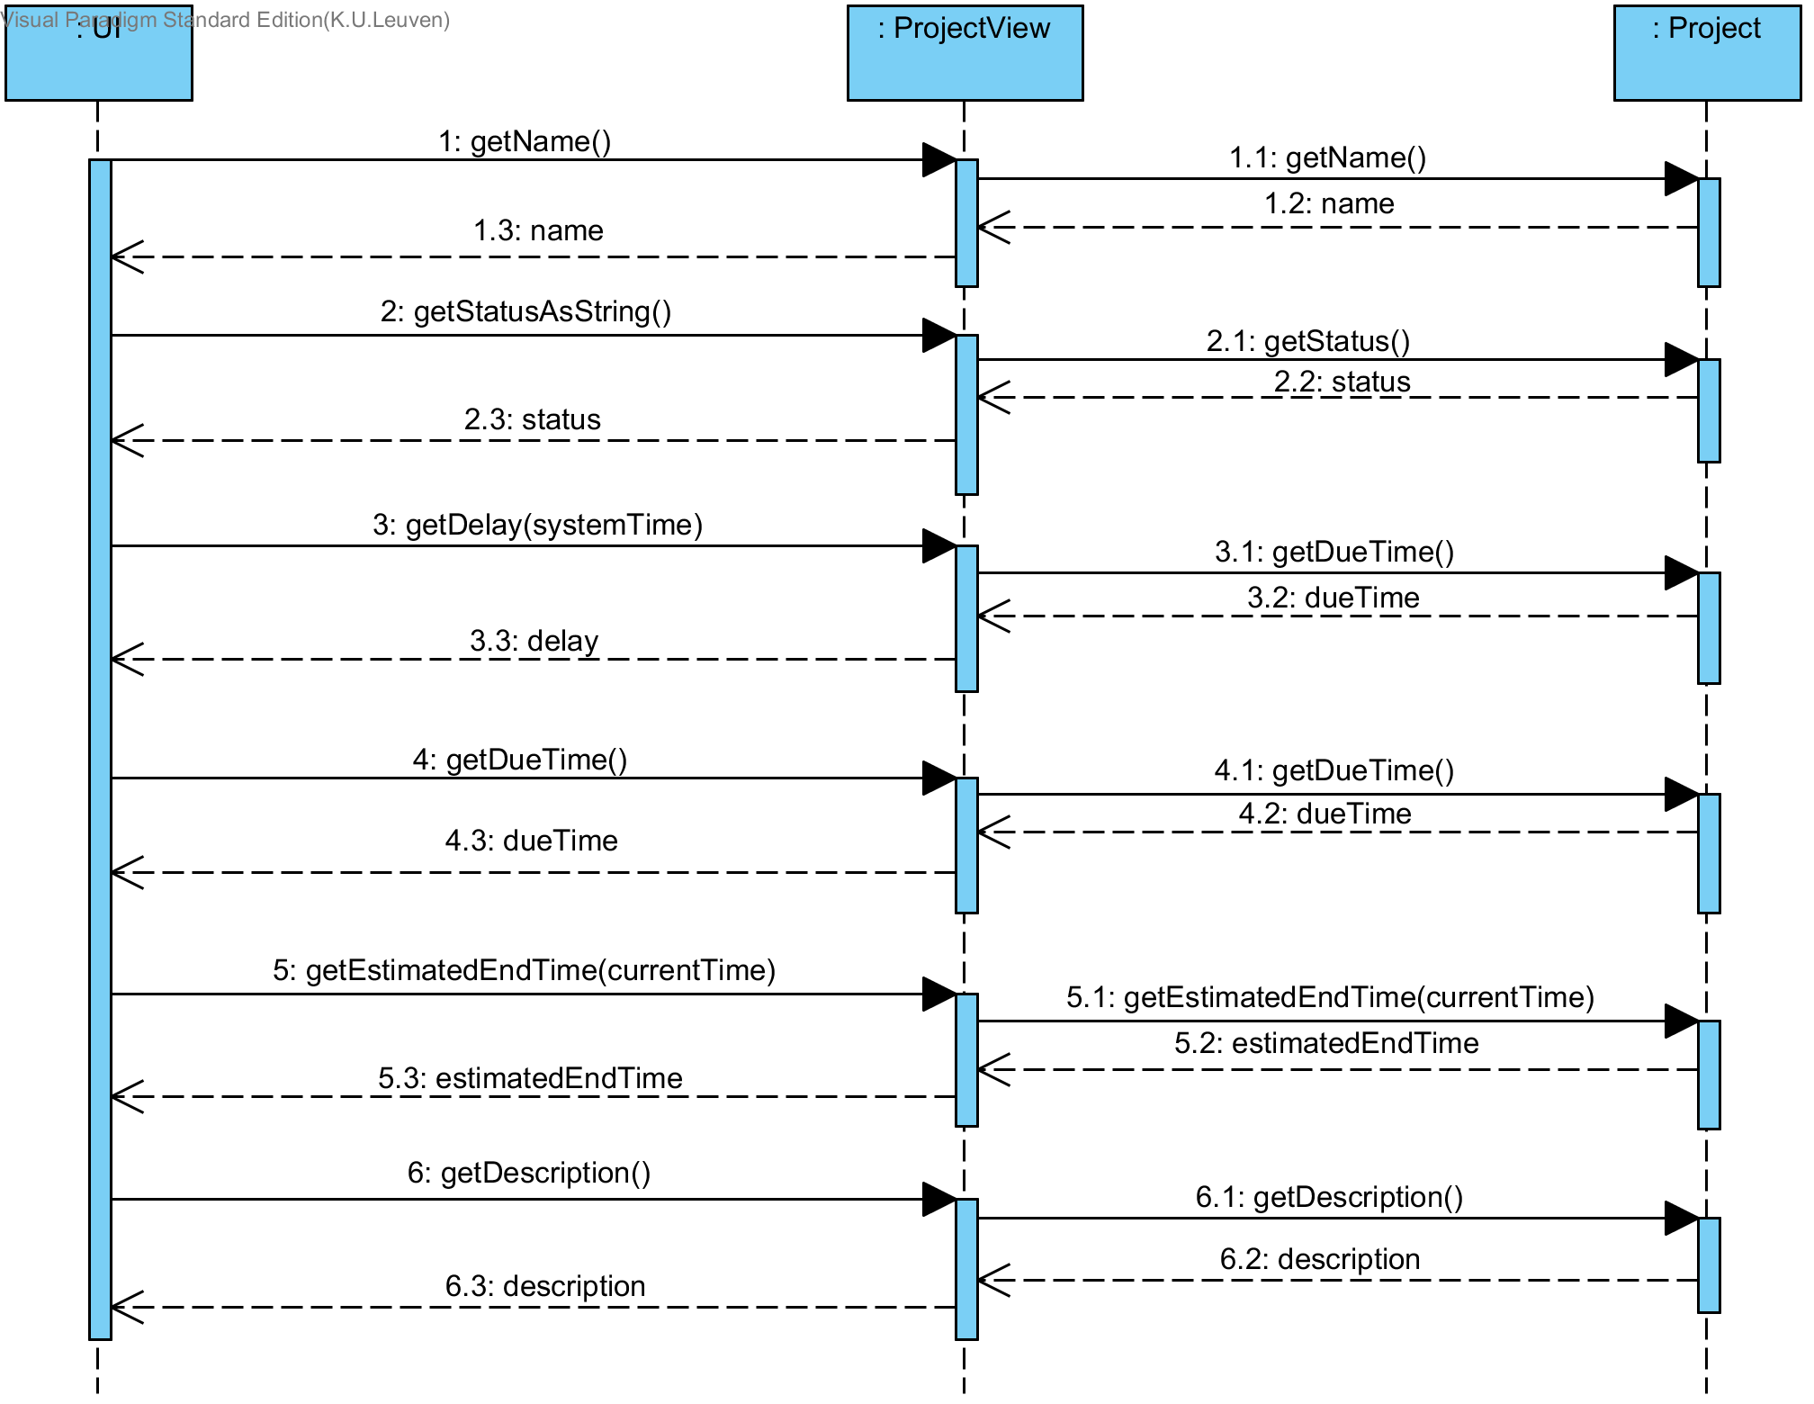
UC1: Project Details

Slide 12
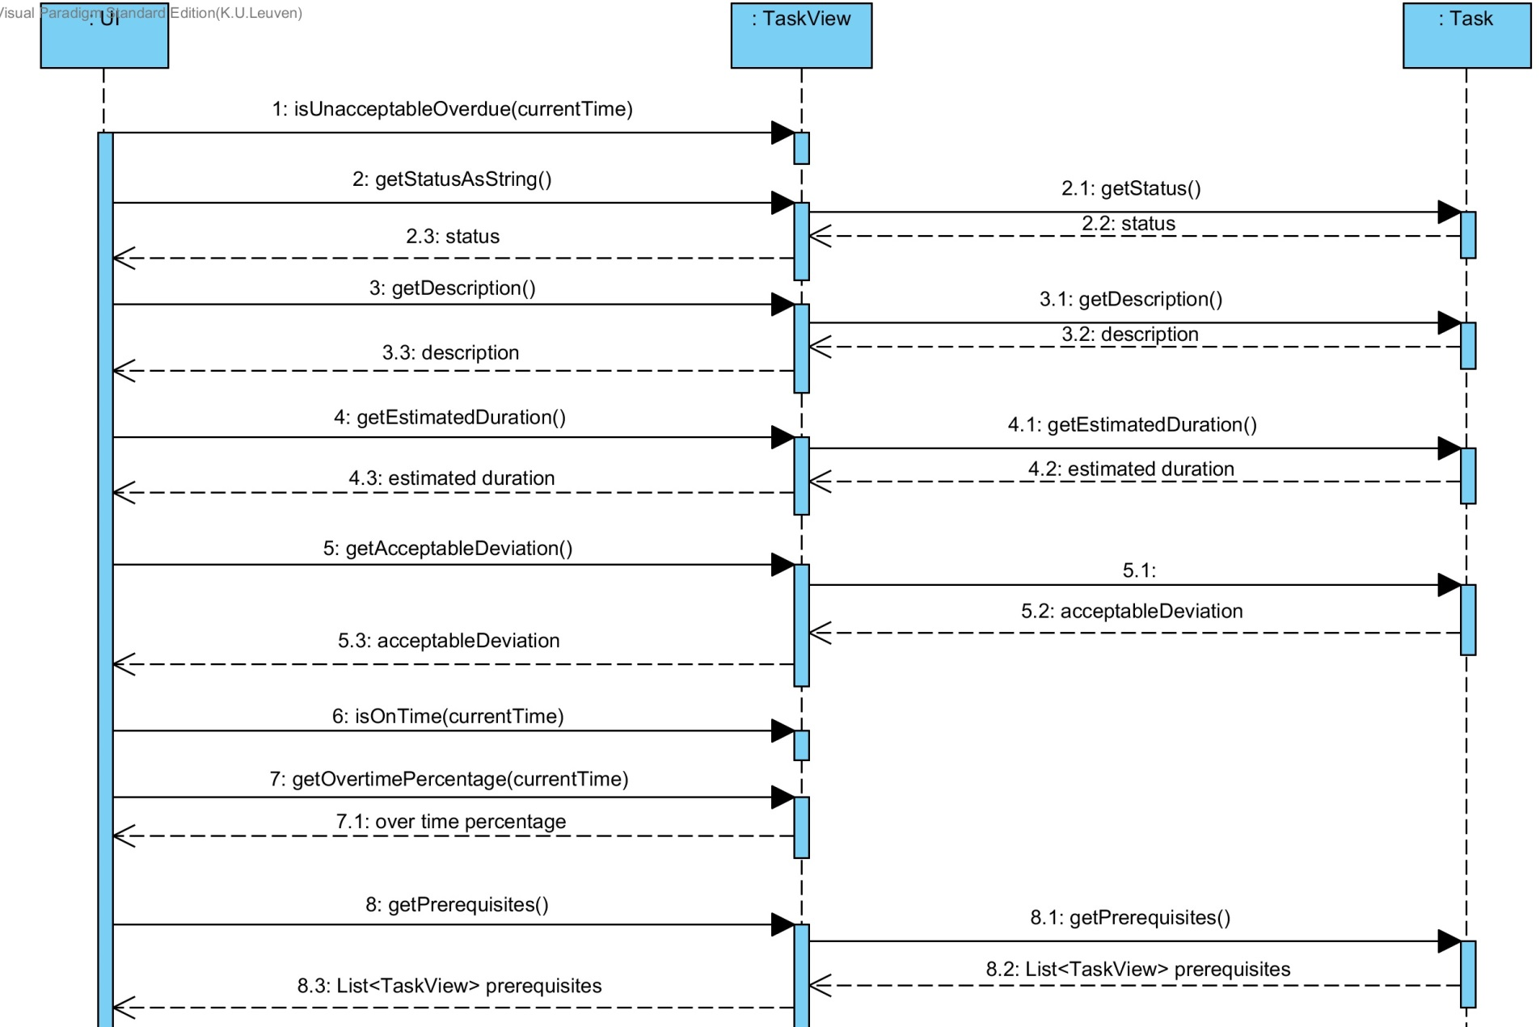
UC1: Task Details part 1

Slide 13
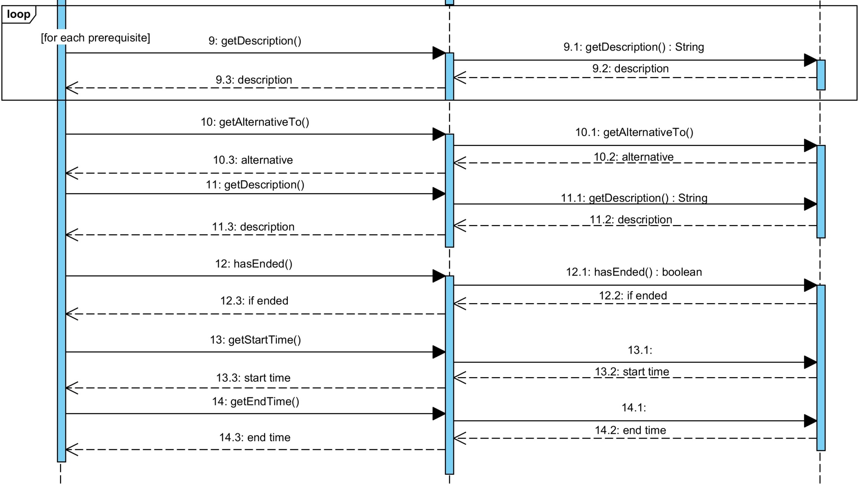
UC1: Task Details part 2

Slide 14
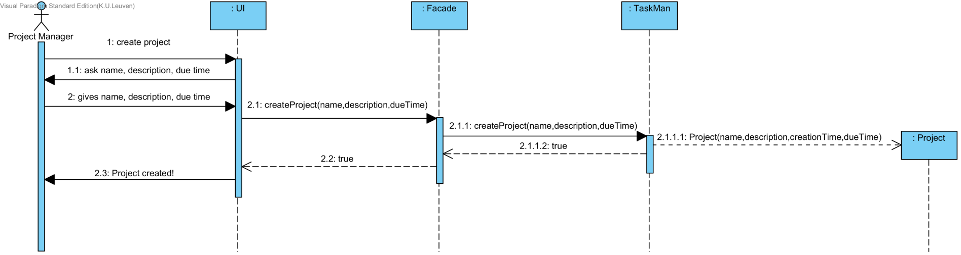
UC2: Create Project

Slide 15
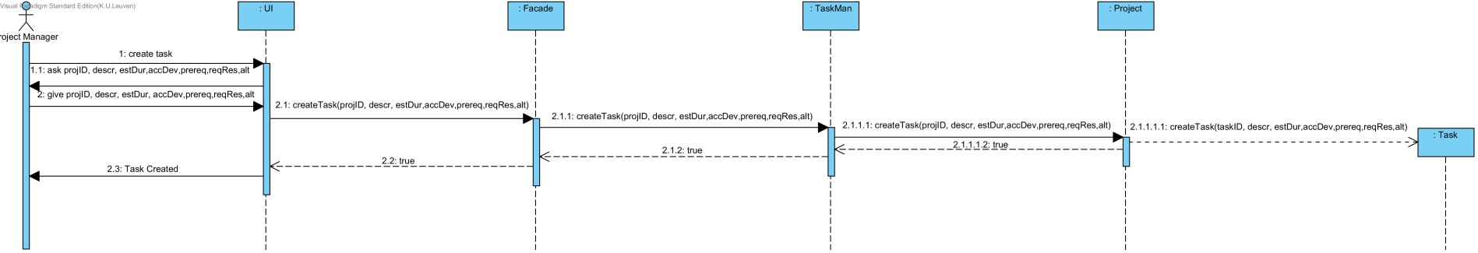
UC3: Create Task

Slide 16
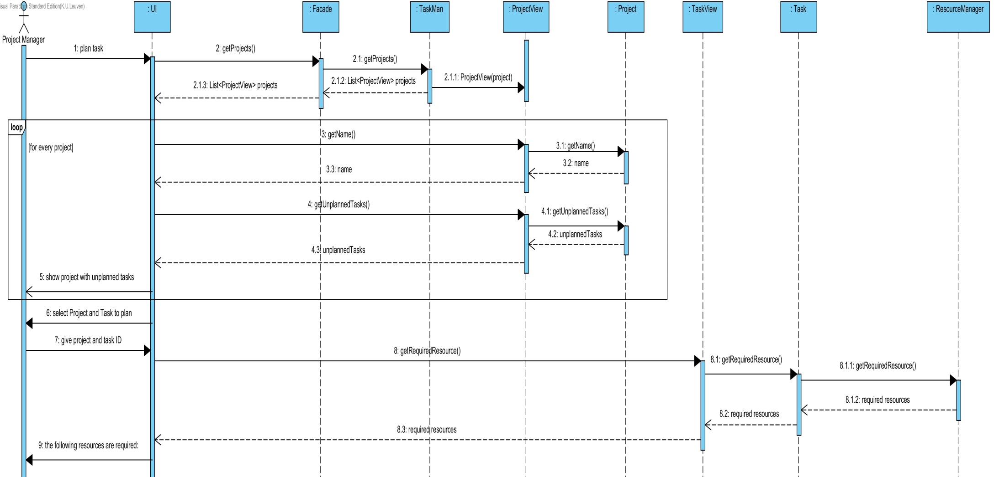
UC4: Plan Task

Slide 17
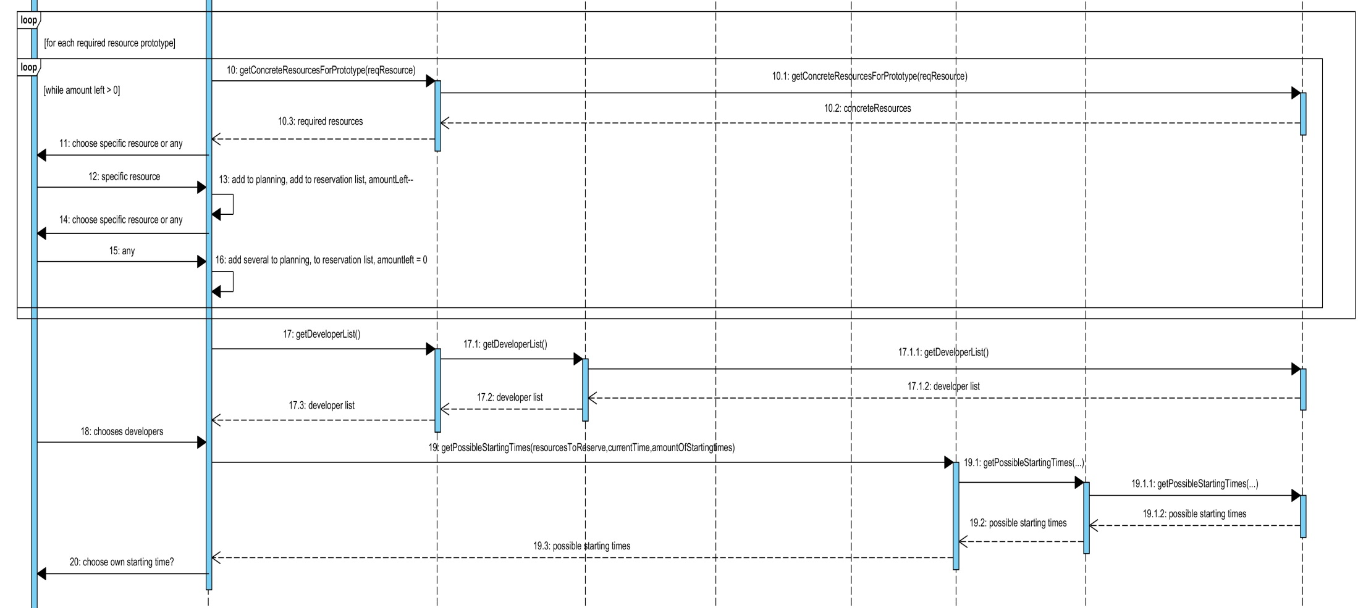
UC4: Plan Task part 2

Slide 18
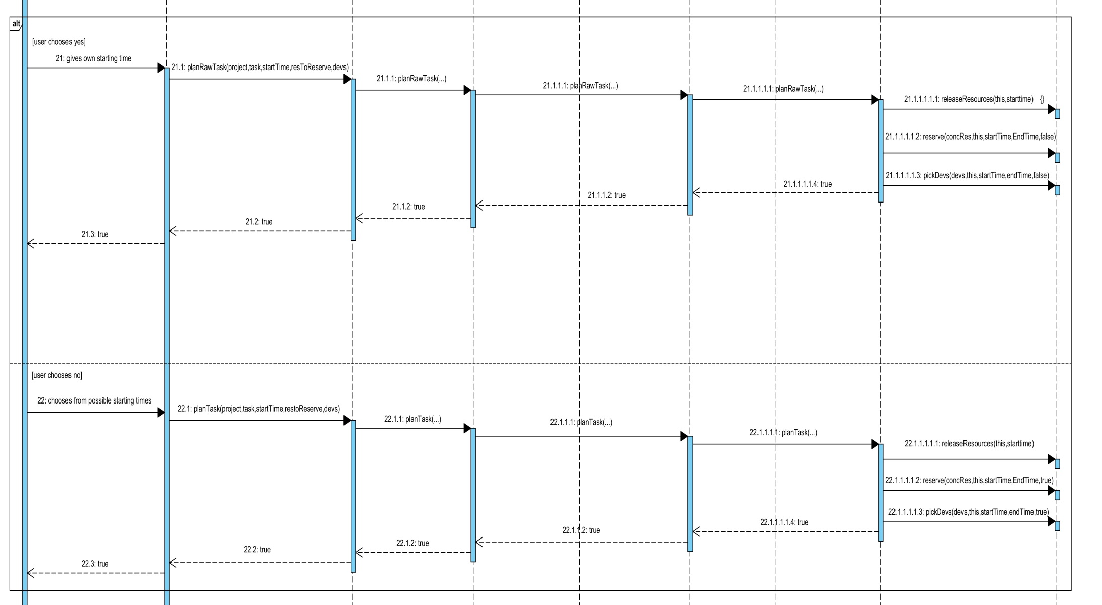
UC4: Plan Task part 3

Slide 19
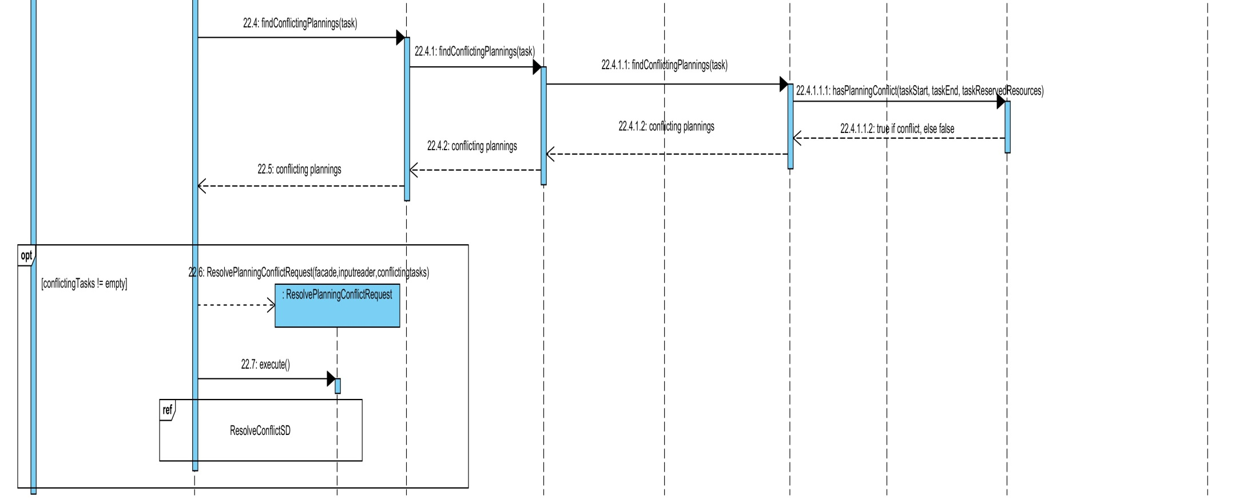
UC4: Plan Task part 4

Slide 20
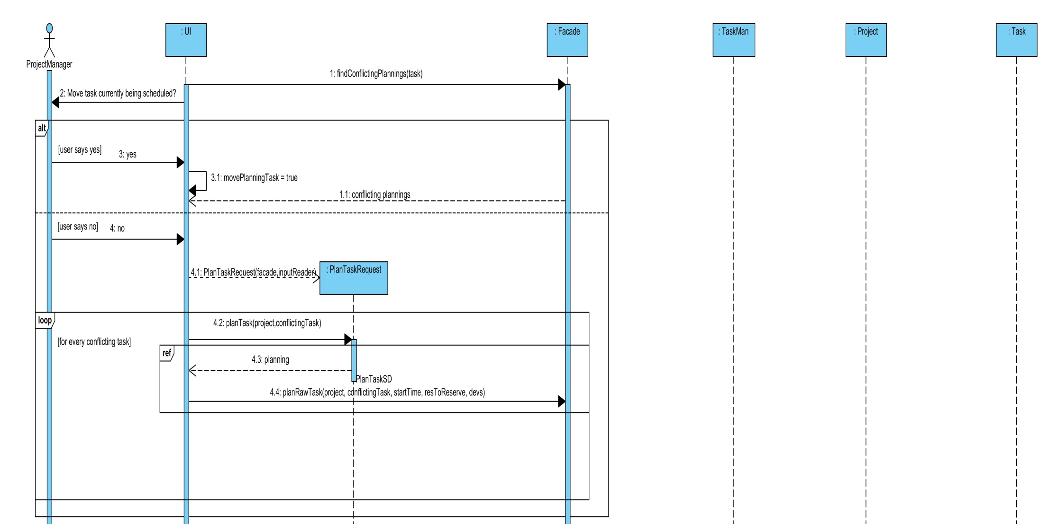
UC5: Resolve Conflict

Slide 21
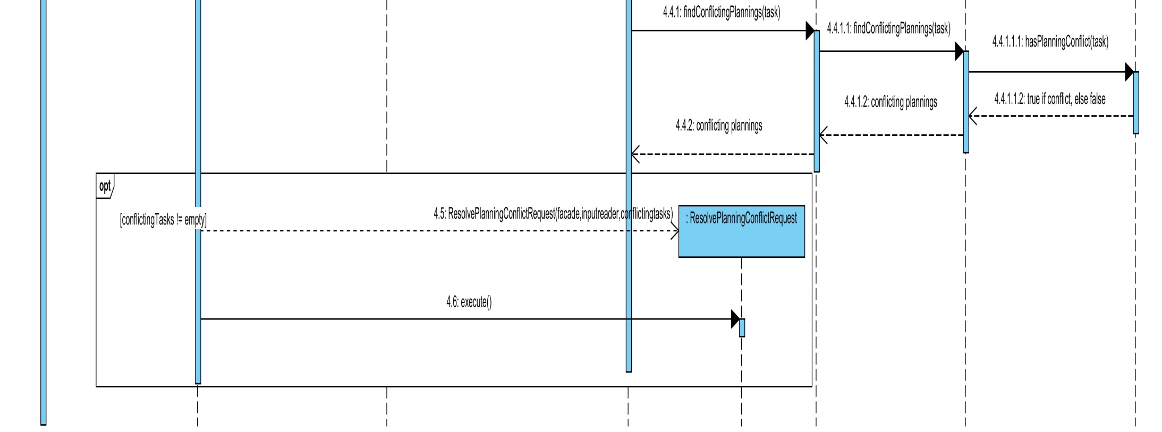
UC5: Resolve Conflict part2

Slide 22
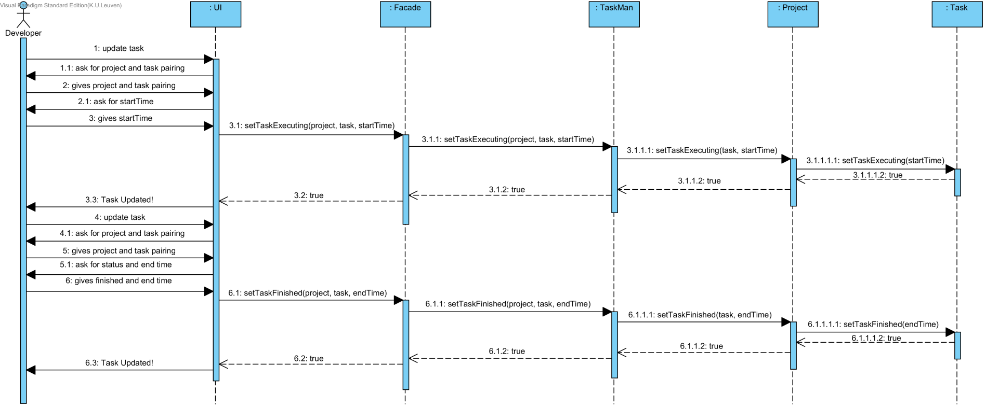
UC6: Update Task Status

Slide 23
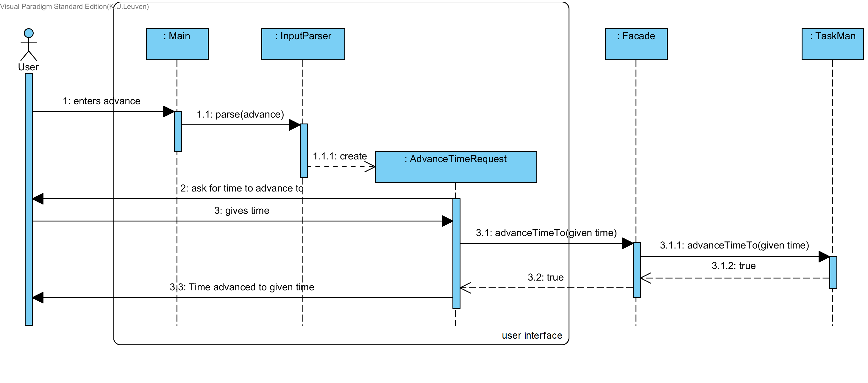
UC7: Advance Time

Slide 24
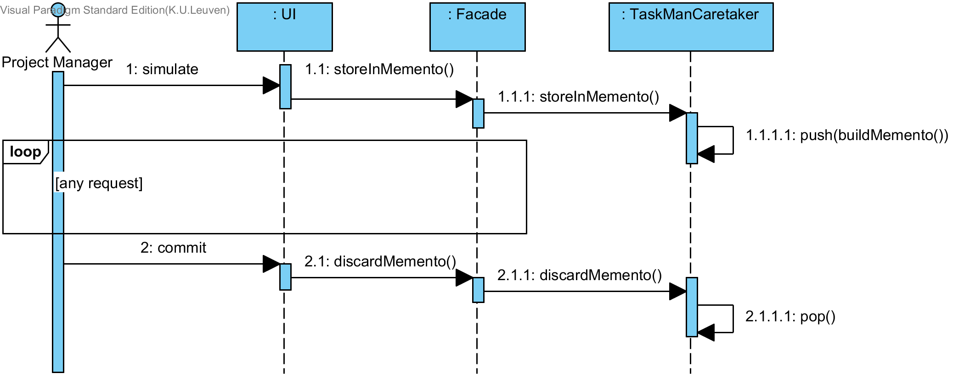
UC8: Simulation Commit

Slide 25
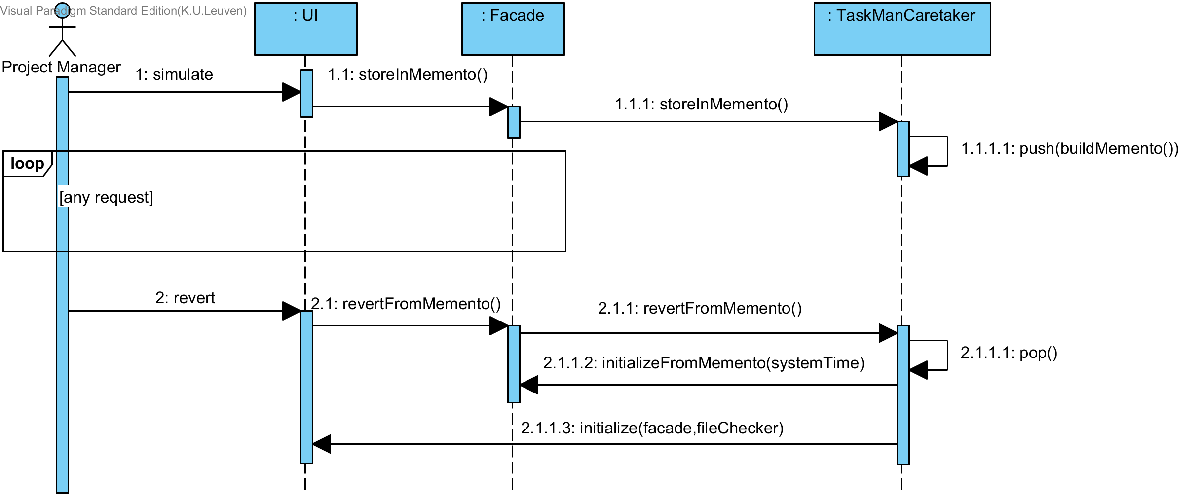
UC8: Simulation Revert

Slide 26
Testing

Slide 27
Testing - Testsuite
Demonstratie

Slide 28
Werkverdeling
Format: (Estimated) group / individual / study
Vincent Van Gestel: Wildcard now, ? Next
?/40/12
Joran Van de Woestijne: Domain coordinator now, ? Next
?/?/?
Tim Van Den Broecke: Design coordinator now, ? Next
?/?/?
Eli Vangrieken: Testing coordinator now, ? Next
70/30/10

